Slide 1


Intro to Blender
Disclaimer: We (probably) won’t be creating this image.

Slide 2
What is Blender?
Blender is a very versatile program. Its main purpose is to let you create and manipulate virtual 3D scenes. It also has numerous other features that build on that core functionality, including but not limited to:
Rendering engines to create photorealistic images and videos
A video editor that can be layered with renders for special effects
Material creation to create any material or surface you can imagine
A compositor for Photoshop type image effects
Physics simulation engines for solids, liquids, cloth, hair, springs, motors… etc.
Game creation
The capability to make your computer completely unresponsive no matter how powerful it is
Probably a whole bunch of other stuff that I forgot or still don’t know about
While all these functions are pretty awesome, today we are going to be focusing on Blender’s modeling and sculpting tools.

Slide 3
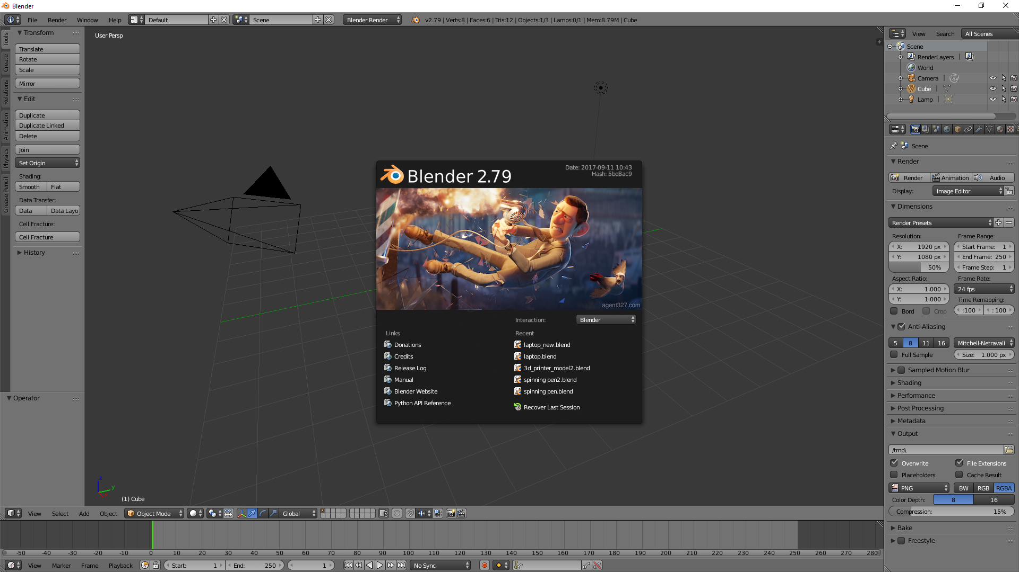
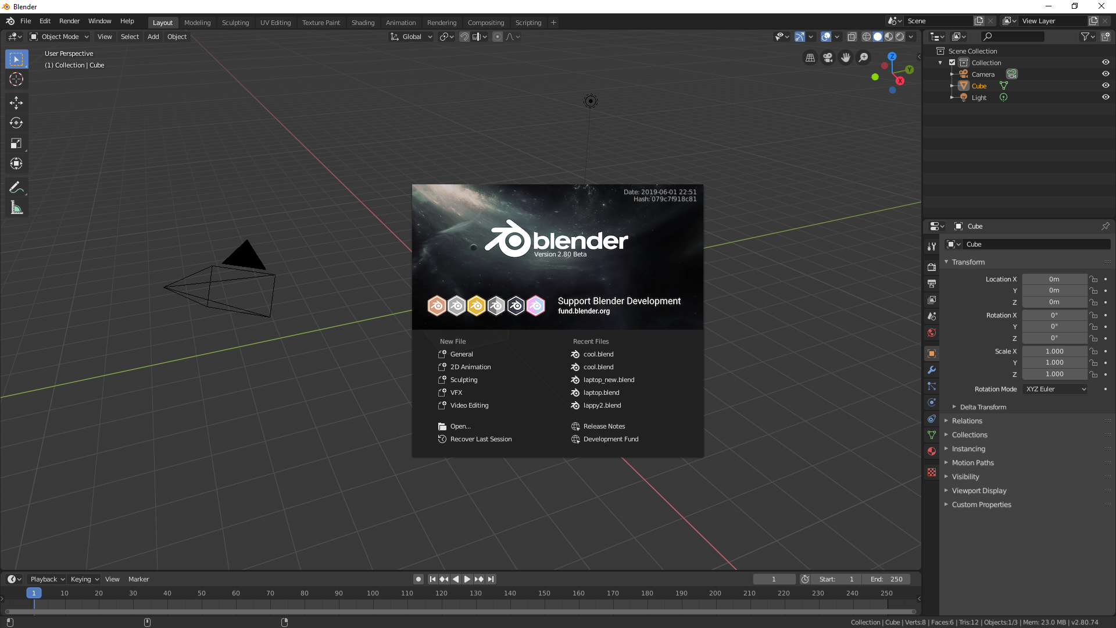
Blender 2.8
2.79 is the latest stable version, but this course will use 2.8 Beta.
2.8 is more streamlined and intuitive, and it’s scheduled for release in October.
2.79
2.8 Beta

Slide 4
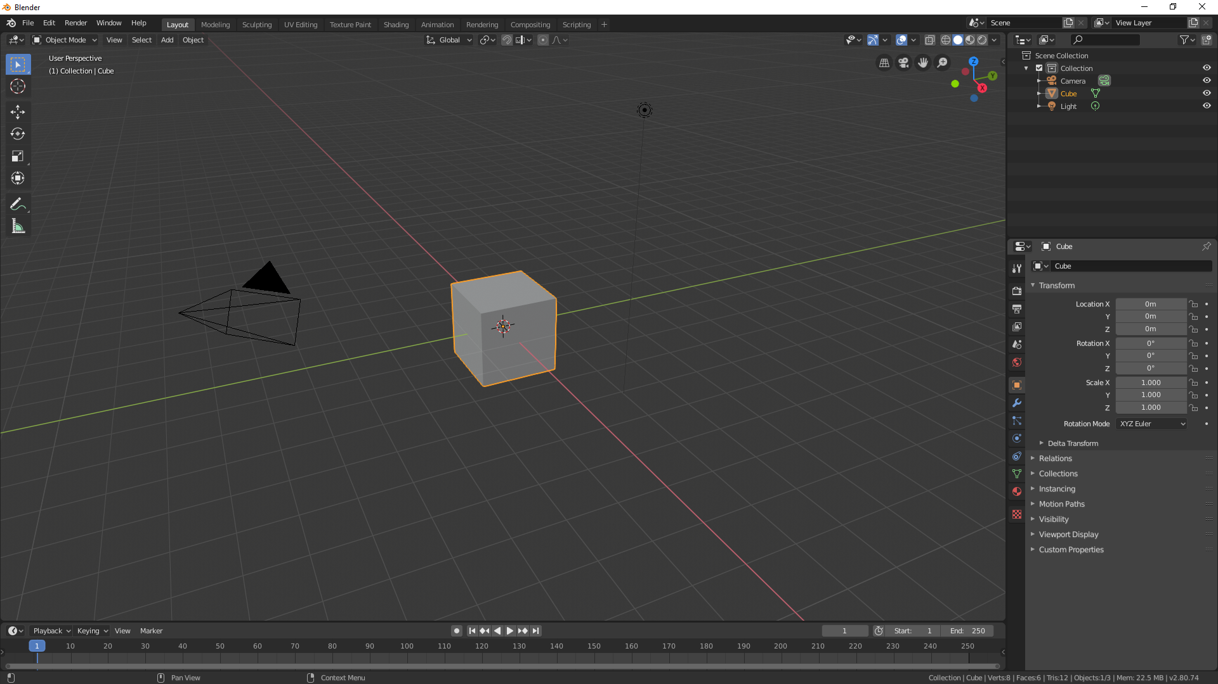
Layouts
Timeline`

Slide 5
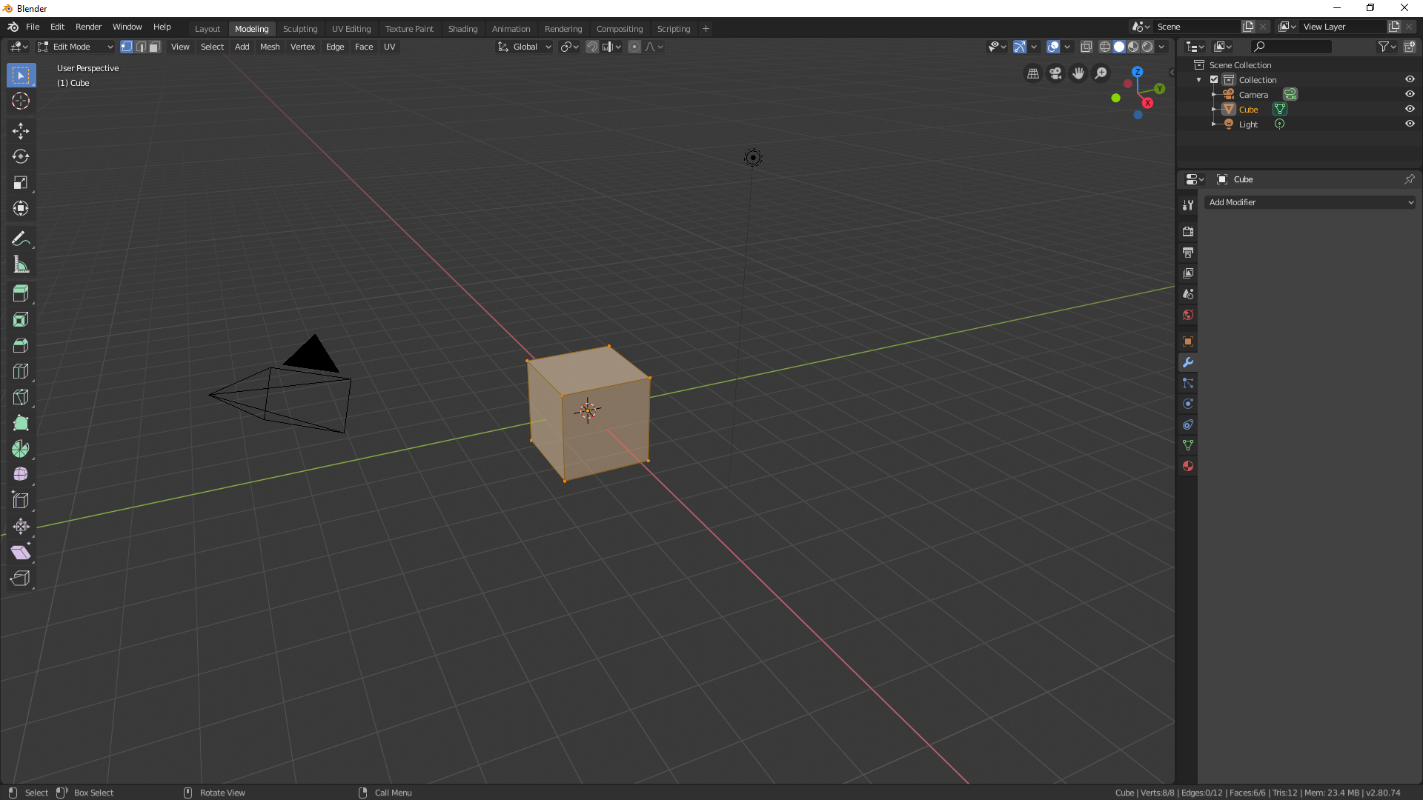
Outliner
Tools
Properties Panel
Control hints

Slide 6
Motion controls
Rotate view
Zoom
+
Move view
SHIFT
W
E
Up
SHIFT
Exit
+
~
`
Fly
SHIFT
A
S
D
Q
Go faster
Down
Left / Right / Forward / Backward
~
`
Focus on selected

Slide 7
Object manipulation controls
TAB
Toggle edit mode
G
Grab & move
Apply
R
Rotate
ESC
Cancel
S
Scale
CTRL
+
Z
Undo

Slide 8
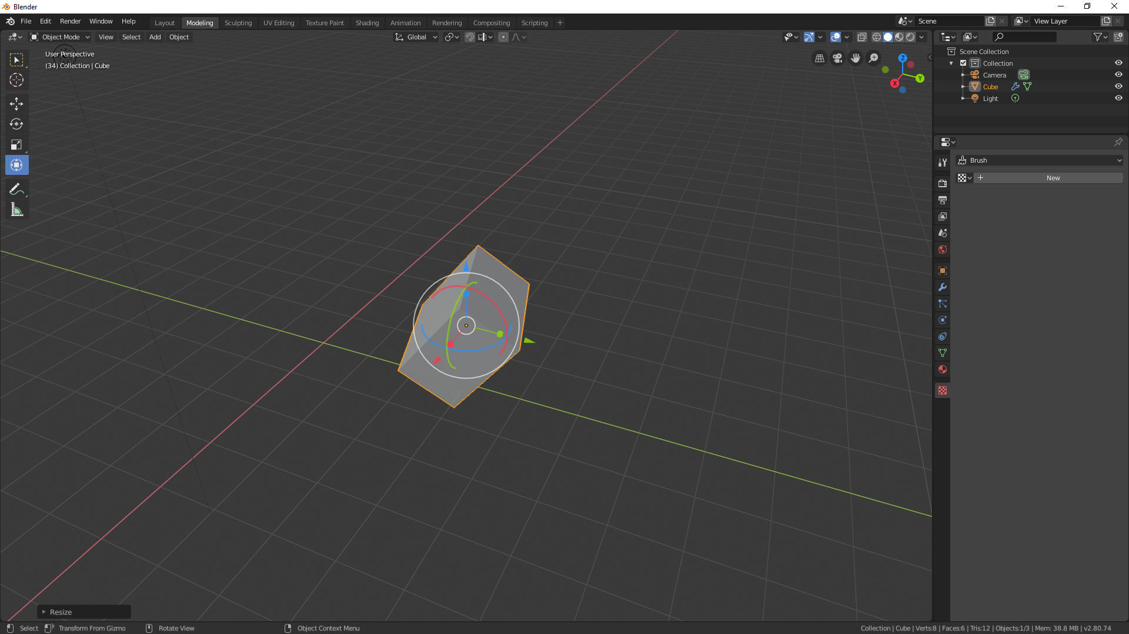
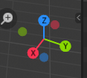
Transformations along axes
X
Y
Press while you’re rotating, scaling, or moving an object to restrict the transformation to one axis.
Z
X
Y
+
Restricts transformation to the other two axes.
SHIFT
Z

Slide 9
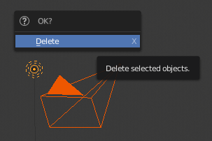
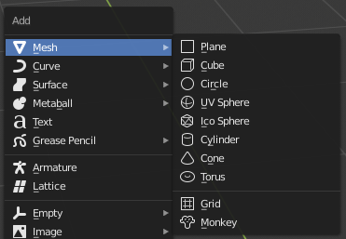
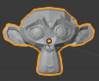
Adding and removing objects
Select objects, hold to select multiple
SHIFT
We don’t need the camera or the lamp right now, so you can practice on them.
X
Delete objects
+
A
Add object
You’ll get a lot of options on the add object menu, but for now let’s stick to basic mesh shapes like Sphere, Cube, or Monkey.
SHIFT

Slide 10
Units

Slide 11
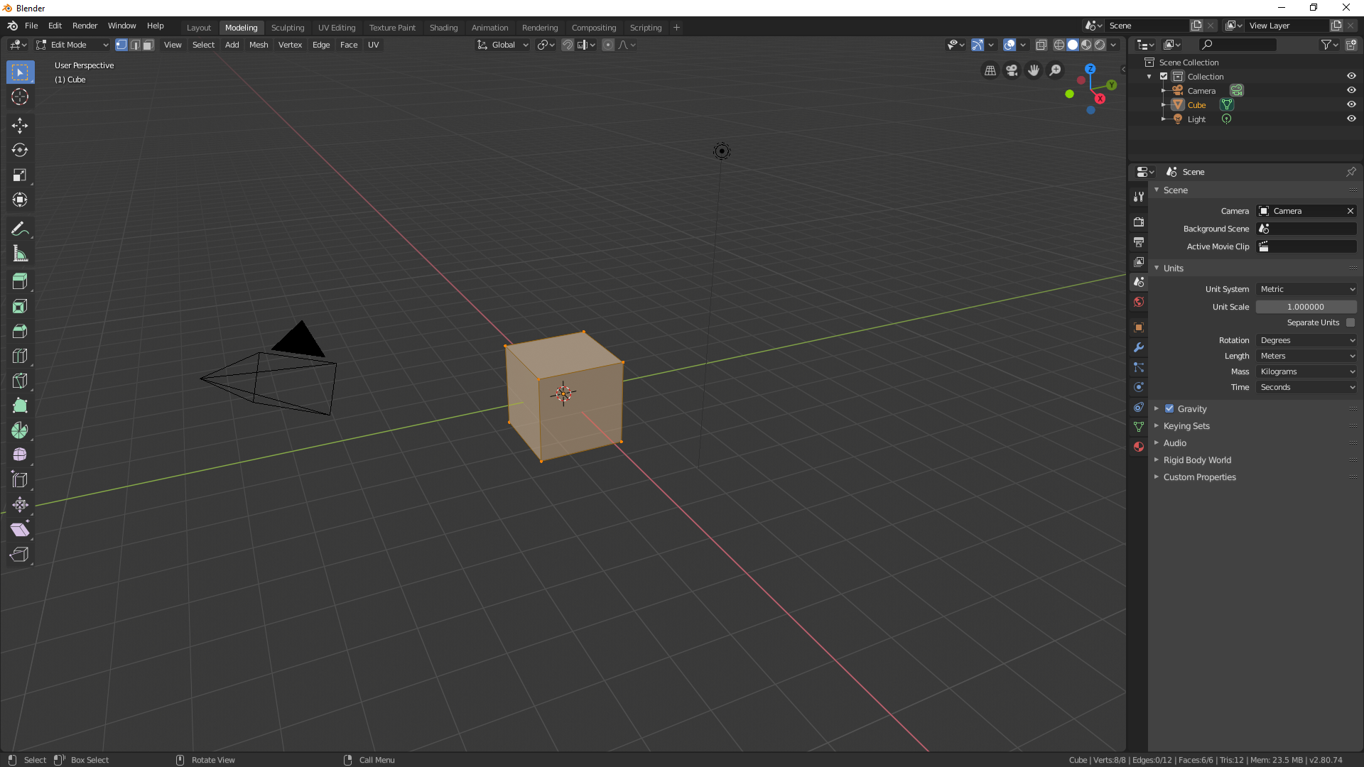

Slide 12
Transformation by numerical value
While doing an object transform, you can type in a number.
Moving and Rotating: The object will move that many of the default unit (e.g. meters or degrees)
Scale: The object’s current size will be multiplied by the number. Keep in mind that this relates to size, not area.
You can also use decimals and negative numbers.

Slide 13
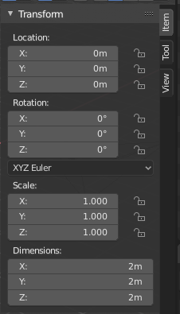
Transform panel
Press
N
To open the Transform panel:
You can type any combination of any applicable units into this panel.
1 foot 2mm 6” – (6/2) centimeters
is a valid entry. Everything will be automatically combined and converted to the units you selected.

Slide 14
Object Editing

Slide 15
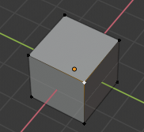
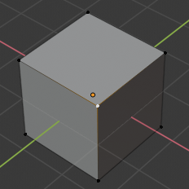
Edit mode
Hit
TAB
To enter edit mode.
Objects are composed of interconnected vertices. All the transformation controls we learned for whole objects also work on vertices or groups of vertices.
You can click vertices to select them. Note that if you select all the vertices on a face, the face itself will also be selected.

Slide 16
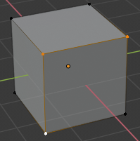
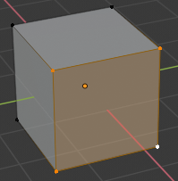
Selecting multiple vertices
SHIFT
Hold to select multiple vertices.
Note that if you select all the vertices on a face, the face becomes selected.

Slide 17
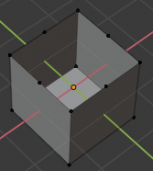
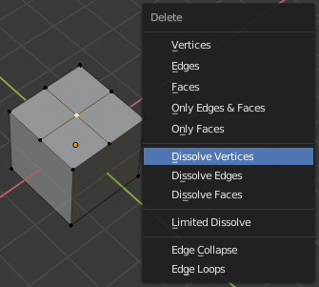
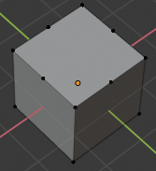
Removing vertices
X
Vertex delete menu
Delete:
Dissolve:

Slide 18
Modeling tools

Slide 19
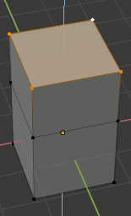
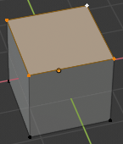
Extrusion
E
Extrude
Confirm
If you press ESC to cancel an extrusion, the new vertices will end up right on top of the existing ones. Be sure to dissolve the duplicates before you start again.
!

Slide 20
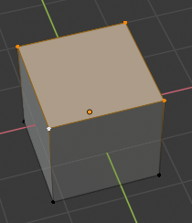
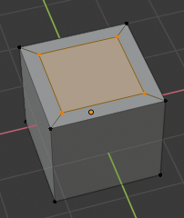
Inset
I
Inset
Confirm

Slide 21
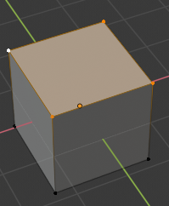
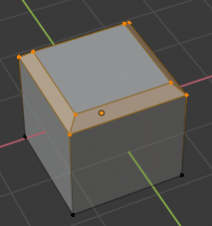
Bevel
CTRL
+
B
Bevel
Confirm

Slide 22
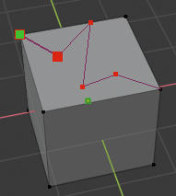
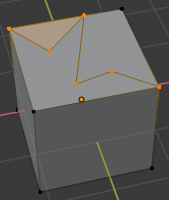
The Knife tool
K
Knife tool
New vertex
SPACE
Apply cuts

Slide 23
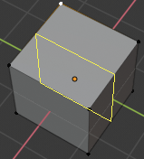
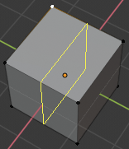
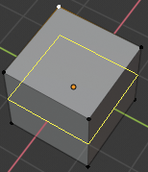
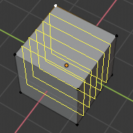
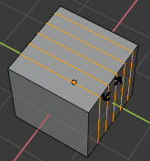
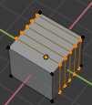
Loop cuts
CTRL
+
R
Loop cut
Place the cursor next to the edge you want the loops to run across.
Roll the mouse wheel a few times to select the number of loops.
Click twice to confirm, slide loops in between if desired.

Slide 24
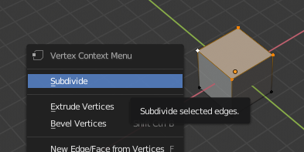
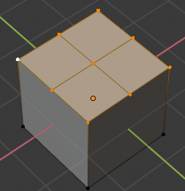
Subdivision
Subdivision splits the selection up so there are more vertices. This allows you to have more detail in your object.
Opens the vertex context menu.
Subdivide is the first choice.
Result:

Slide 25
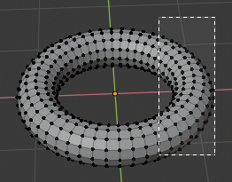
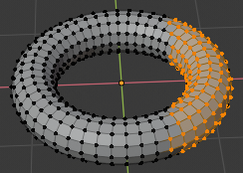
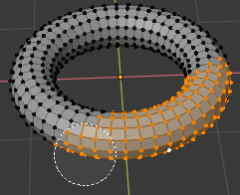
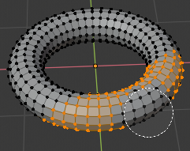
Selection modes
B
Box Select
C
Circle Select
Roll mouse wheel to adjust circle size
Select
Deselect
Esc
Exit circle select

Slide 26
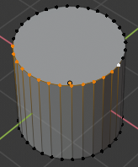
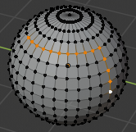
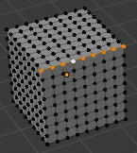
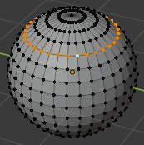
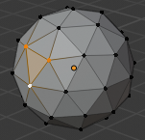
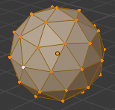
More ways to select vertices
CTRL
Selects the shortest path between two vertices.
ALT
+
Selects edges and loops.
Selects all vertices connected (linked) to the current selection.
CTRL
+
L

Slide 27
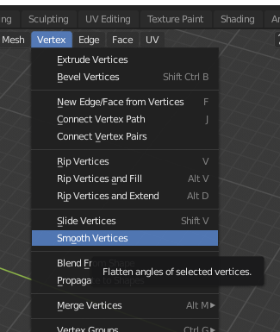
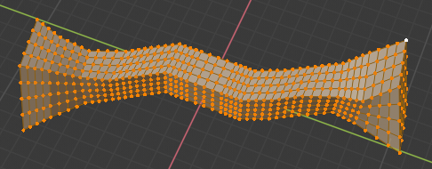
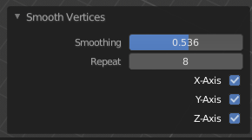
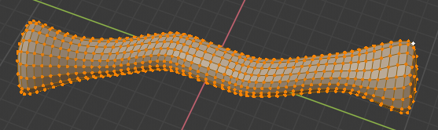
Smoothing
It can be difficult to create smooth, curvy models. Blender has a tool to smooth all or part of a model, accessible from the Vertex menu.
Higher settings = smoother

Slide 28
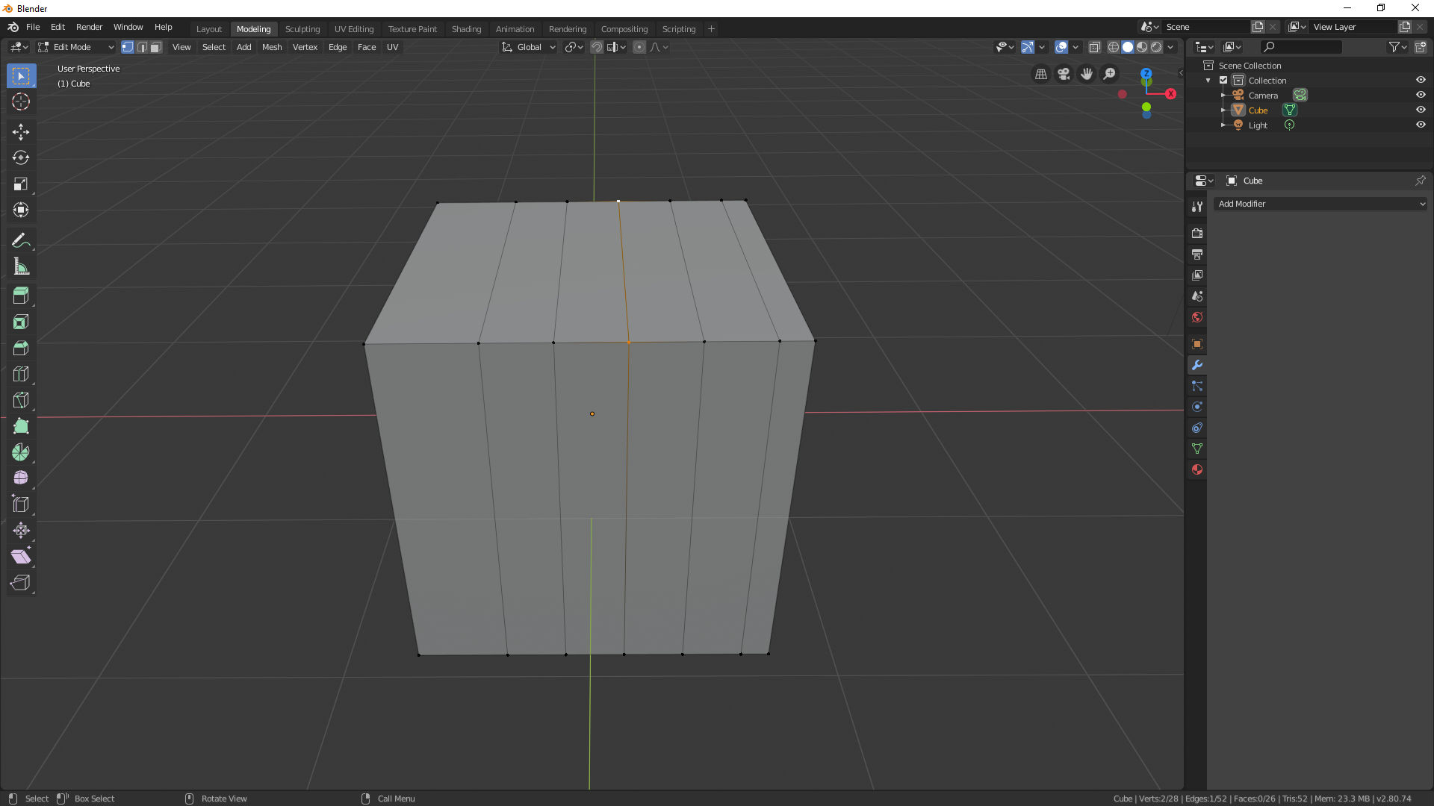
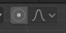



Proportional Editing
Toggle proportional editing
O
Use the mouse wheel to control the size of the effect.

Slide 29











Proportional Editing modes
Smooth
Sphere
Root
Inverse square
Sharp
Linear
Constant
Random
Connected only
Projected from view

Slide 30






Can you make this?
1
2
3
4
5
6

Slide 31






Object Parameters
When you insert a new object, a menu will appear. This menu lets you adjust size, detail and location of the object. I’m using the sphere as an example, but it’s slightly different for each shape.
200 segments and rings
4 segments and rings

Slide 32


Orthographic View
5
Toggle Orthographic view
Perspective can often misrepresent objects. Take the laptop on the left, for example. We know that the keyboard/palmrest and screen sections are the same size, but the palmrest looks massive due to perspective.
Orthographic view shows everything at the same scale, regardless of distance from the viewport. In other words, objects don’t appear smaller as they move further away. With Orthographic view enabled, it becomes clear that both sections of the laptop are the same size, at least in width.

Slide 33




Face, Edge, and Vertex modes
Mode selector. Hold Shift for more than one.
Vertex mode is the default. It’s the only one we’ve been using so far.
Edge and face modes allow you to select and manipulate entire edges and faces respectively. This saves you the time of manually selecting a bunch of vertices.

Slide 34



Adding/removing faces
Creates a face from the selected vertices. If only two are selected, and edge will be created instead.
F
On the Delete menu, you can choose Only Faces or Only Edges & Faces to preserve vertices.

Slide 35


Triangles vs Polygon faces
A plane is mathematically defined by three points. However, Blender allows faces to have as many vertices (points) as you want. This can be convenient for situations like the object shown on the left, but can also cause confusion.
?
?
?

Slide 36



Triangulating
(Not to be confused with what GPS satellites are used for)
CTRL
+
T
Triangulate faces
If you’re unhappy with the results, you can adjust modes in the menu on the lower left for slightly different shapes.

Slide 37



Modifiers
Modifiers apply some effect to an object. There are quite a lot of them, but you’ll probably only use a few on a regular basis.
The modifier list will be empty to start. As you add modifiers, they’ll appear in order.

Slide 38











Boolean Modifier
The Boolean modifier can add or subtract objects to and from one another. It is very useful for modeling.
The Boolean modifier takes a secondary object as a parameter. Select it by clicking the eyedropper then clicking an object.

Slide 39





Subdivision Surface modifier
“Low-poly” objects are easier to model but look blocky and sharp.
“High-poly” objects are smooth, detailed and beautiful – perfect for renders or 3D prints.
Adjust the number of subdivisions to increase quality
The Subsurf doesn’t need to be applied to see results. You can leave it on and continue modeling!

Slide 40
Coordinates and Positioning

Slide 41




Object origin points
Every object in Blender has an origin point, represented by a small orange dot.
The object’s coordinates refer to its origin point.
It’s the point that the object rotates around and scales from by default.
If you select a vertex in edit mode, its coordinates will be displayed relative to the parent object’s origin point.
If you move an entire object while in edit mode, it’s origin point won’t change. Afterward, go into object mode and try scaling or rotating for some interesting results.
In case you accidentally mess up your origin point, you can use one of the options in Object -> Set Origin to reset it. This menu won’t appear in edit mode.

Slide 42




Local vs Global coordinates
In object mode, all coordinates are relative to the world origin. This is the global coordinate system.
In edit mode, the default coordinate system is local. This means that vertex coordinates are expressed relative to the parent object.

Slide 43






Scale multiplier
When you scale something in object mode, the vertex coordinates stay the same. Instead, the scale multiplier is changed.

Slide 44



Applying scale
The scale multiplier can be confusing, especially if you’re trying to model something with specific measurements. To get rid of it, you can apply the scale transformation.
CTRL
+
A
Apply transformation menu
Choose scale. This will set the scale multiplier to 1 and keep the object the same size. Now the vertex coordinates represent their true positions.

Slide 45


3D cursor
The 3D cursor has several functions:
All newly added objects appear on the 3D cursor
It can be used as a pivot point for rotation and scaling
Motion and scaling can be aligned to it’s axes.
It can be snapped to objects.
Objects can be snapped to the 3D cursor.
All of the above can be used with parts of an object in Edit mode, (but if you move more than one vertex to the cursor, they will all be on top of each other).
Selecting the 3D cursor tool
You can also select the 3D cursor from the toolbar on the left:
SHIFT
+
SPACE
Brings up the tools menu.
SPACE
Pressing again selects the 3D cursor.

Slide 46




3D cursor positioning
While on the 3D cursor tool, you can click anywhere in the scene to place the cursor. This method can be imprecise because the viewport is 2-dimensional.
But after a small rotation of the view…
Looks good,
?!?!?!!?
If you click an object, the 3D cursor will be placed on the surface of the object. It’s more predictable than when you click in empty space.

Slide 47


3D cursor positioning
You can also position the cursor by typing in coordinates. First, press N to open the Transform panel. This sidebar has several other functions as well. Click the View tab, and the 3D cursor panel is the second one down.
The View panel, which contains viewport settings, may be open. Feel free to collapse it by clicking the arrow.

Slide 48

3D cursor snapping
SHIFT
+
S
Brings up the snapping pie menu.
‘Selection to Cursor’ and ‘Cursor to Selected’ are the most commonly used options. Together, they allow you to mark locations, move objects to each other, and precisely position things.

Slide 49
Ray tracing

Slide 50



Light in real life
Starts at the light source
Goes all over the place
Only a little bit of it ends up in your eyes
Very computationally inefficient

Slide 51
Light in Blender
Starts at the camera, so no unseen rays are computed
Directed toward light sources
Looks exactly the same as real life
Very efficient

Slide 52
Render Engines
Eevee (default) is Blender’s realtime engine. It does not use ray tracing. Instead, it uses a process similar to game engines like Unreal or Unity to estimate what a scene should look like.
Cycles is Blender’s ray tracing engine. It is too computationally intense to run in realtime, but it delivers true-to-life shadows, reflections, and lighting. We will mostly be focusing on Cycles today.
Ultimately, Eevee and Cycles aim to be interoperable – that is, you can switch between them and the scene will still look as similar as possible. However, this is a major technical challenge and Eevee is still under development.

Slide 53


Render settings
The settings are different for Eevee, make sure you select Cycles.
Always switch to GPU rendering if available. This is what Graphics cards are designed to do.
Number of Samples (we’ll cover this shortly)
If you’re using a GPU, be sure to set your tile sizes to a high number (usually between 256 and 2048. This has no effect on the viewport, but can nearly triple the speed of final renders.

Slide 54





View modes
From left to right on the widget:
Material displays color and texture but does no light calculations
Rendered is how your scene actually looks
Wireframe is pretty self explanatory
Solid is the default setting

Slide 55



Overlay toggle
To the left of the view modes

Slide 56



Smooth and Flat shading
Useful for creating smooth objects without excessive numbers of vertices. Edges can look a bit funny sometimes.
Flat
Smooth

Slide 57



Samples
A sample consists of a large number of light rays. Increasing sample count results in longer render times, but a higher quality image with less noise. Turning up the samples is similar to taking a longer exposure on a real-life camera, except the light level does not change.
Depending on lighting conditions, you’ll usually want several hundred samples to achieve a high quality image.
Low sample count
High sample count

Slide 58



Denoising
Rendering can take a very long time. Often, it would take too long to use an adequate number of samples. Denoising can drastically increase the image quality of a low-sample render. It can occasionally make the image blurry, but usually there is no drawback to having it enabled.

Slide 59
Materials

Slide 60

Splitting view areas
While you’re working on materials, it’s useful to have two view areas so you can view and edit the material at the same time.

Slide 61


Splitting view areas
Move your mouse to just below the upper right corner of the viewport. The cursor should be a little plus shape. Then, drag down and to the left.

Slide 62




The shader node editor
Every view area in Blender has a menu in the upper right that allows you to change its type. Let’s change our Right 3D view to a Shader Editor.

Slide 63

Nodes
Materials in Blender are created using nodes. Nodes are blocks that can pass out and receive data through wires. They are similar to functions in math or coding, but they don’t work with single numbers. Instead, they operate on an effectively infinite group of numbers that represents every part of an object all at once.
Detail is automatically added and removed as necessary, so you don’t have to worry about lag.
Output
Wire
Inputs

Slide 64



Setting up the environment
Right now, the sky is a boring solid grey, represented by these two nodes.
Let’s add an Environment texture node by using Shift + A and searching for it.

Slide 65

Setting up the environment
The environment texture node uses a 360° HDR photograph as the sky. We’ll use spruit_sunrise_4k.hdr. HDR photos have light as well as image data embedded in them, So the sun in the photo will act like a realistic light source.
Next, plug the color from the environment texture node into the background node. You should get a beautiful background to your world!

Slide 66


Shader types
There are three shader types: Object, World, and Line Style.
World controls the sky and the environment.
Line Style controls 2D drawings.
Object controls the material for every 3D object.
Switch to Object mode using the menu to the right of the view mode menu.

Slide 67

The Principled shader
The Principled shader can create almost any surface that exists in real life. It’s also a standard format, so it’s interoperable with other software like Unreal Engine or Disney’s Renderman. There are a lot of controls, but most of the time you’ll only use a few.

Slide 68


Metallic
Makes the material look like metal.

Slide 69


Specular
Adjusts the surface reflectivity of the material. Only applicable to non-metallic materials.

Slide 70



Roughness
Adjusts the surface roughness. This might look similar to Specular, but they aren’t the same thing. As roughness changes, the same amount of light is reflected, it’s just scattered more or less randomly. That’s why the high-roughness object looks a slightly brighter color: The reflection of the sun is getting scattered in all directions.

Slide 71



Anisotropic
You’ll often see this effect on pots, pans, and metal knobs. It only works on metallic materials. You can also adjust the rotation using the next slider down.

Slide 72


Clearcoat
Clearcoat is a pretty subtle effect. It simulates a thin, clear layer over the material. It works on any material, but it’s most visible and commonly used with metallic ones. It’s useful for creating automotive paint.

Slide 73


Transmission
Makes a material transparent.

Slide 74


IOR (Index of Refraction)
Controls the angle that light refracts as it passes in and out of the material. Most glass has an index IOR of 1.4-1.5, and water has an IOR of 1.33.

Slide 75


Transmission Roughness
Scatters light as it passes through the material. Notice how the surface is still shiny, but the inside is cloudy. This setting is very computationally intense and requires a LOT of samples!!

Slide 76


Emission
If this color isn’t black, the object will emit light. It will still reflect its base color when it receives light from other sources.

Slide 77



Alpha
Lets light pass right through the object.

Slide 78
Types of node data
Gray is numerical data. Often “gray data” is on a scale of 0 to 1, but not always. True/false data also uses gray plugs – it’s just 0 or 1.
Yellow is color data. It can be split into its red, green, and blue components and represented as three gray wires. If it’s plugged into a gray socket, it will automatically be converted to grayscale.
Purple is vector data. It represents angles or positions. A good use case for vector data is the angle of the surface to the camera when you’re creating iridescent materials.
Green is shader data. It represents a material that can be put on an object and rendered. Green outputs can only be plugged into green inputs.

Slide 79


Multiple nodes to create a material
To create complex and interesting materials, you will usually need many interconnected nodes.
Let’s add a Noise Texture node and plug it into the base color of our Principled shader.
Notice how the one wire passes color information for the entire object.

Slide 80



The ColorRamp node
The ColorRamp node maps a 0-1 input to a color output. The colorful noise is automatically converted to a number. Using the Fac(tor) output on the Noise Texture node would produce the same result.
Try adjusting the color stops and see what happens to the material!

Slide 81


The ColorRamp node
Sometimes, it’s useful to combine multiple ColorRamp nodes for finer control over your color.

Slide 82


Bump mapping
Bump mapping allows you to add 3D texture to your object without changing the geometry. Light reflects off bumps as if they are real geometry. However, the actual vertices don’t change.
Bump maps are vector data, which is represented as purple. They plug into the Normal slot of the Principled shader. Normal is the technical term for the direction that the surface is facing.
Try recreating this setup. Note that the Noise texture scale is set really high, and the bump strength is turned down.

Slide 83
Other nodes to cover
Texture coordinate/mapping
Brick Texture
Math
Emission
Add Shader
Diffuse
Bright/Contrast
Layer Weight

